Slide 1

Clustering and Predictive Modeling for Customer Engagement and Activation
January 2022
Notes:
Gathering slide

Slide 2

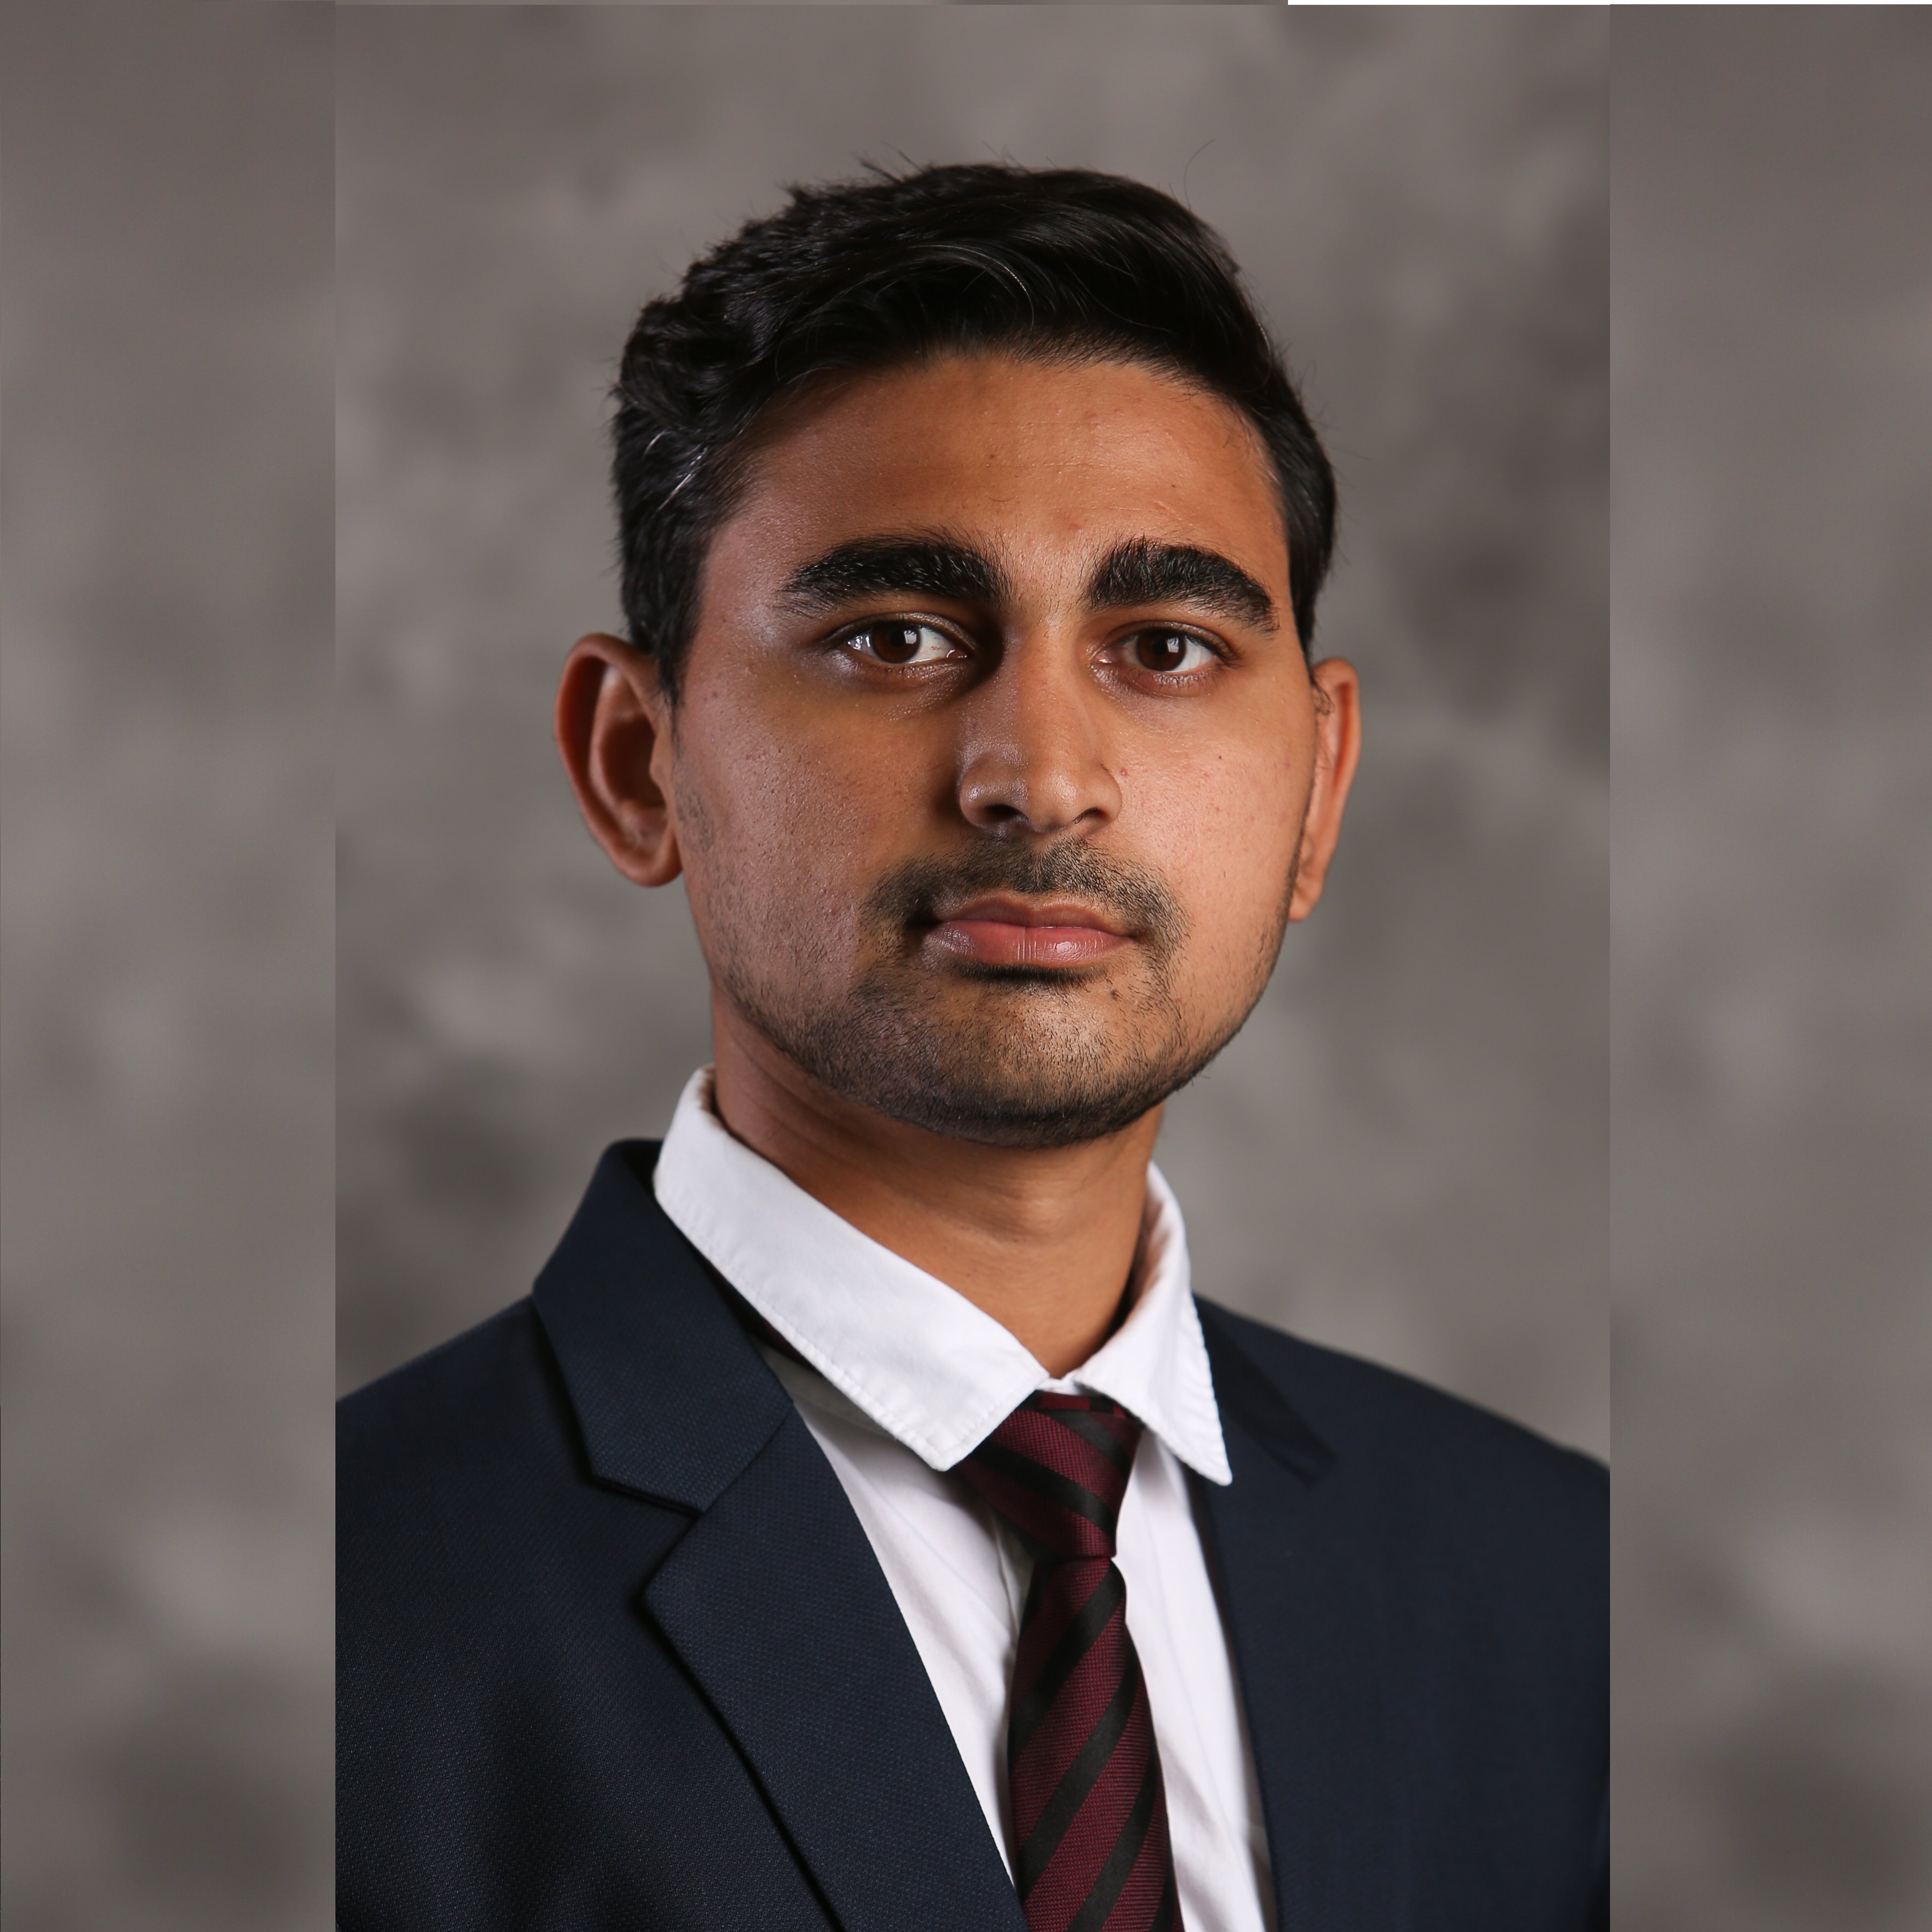
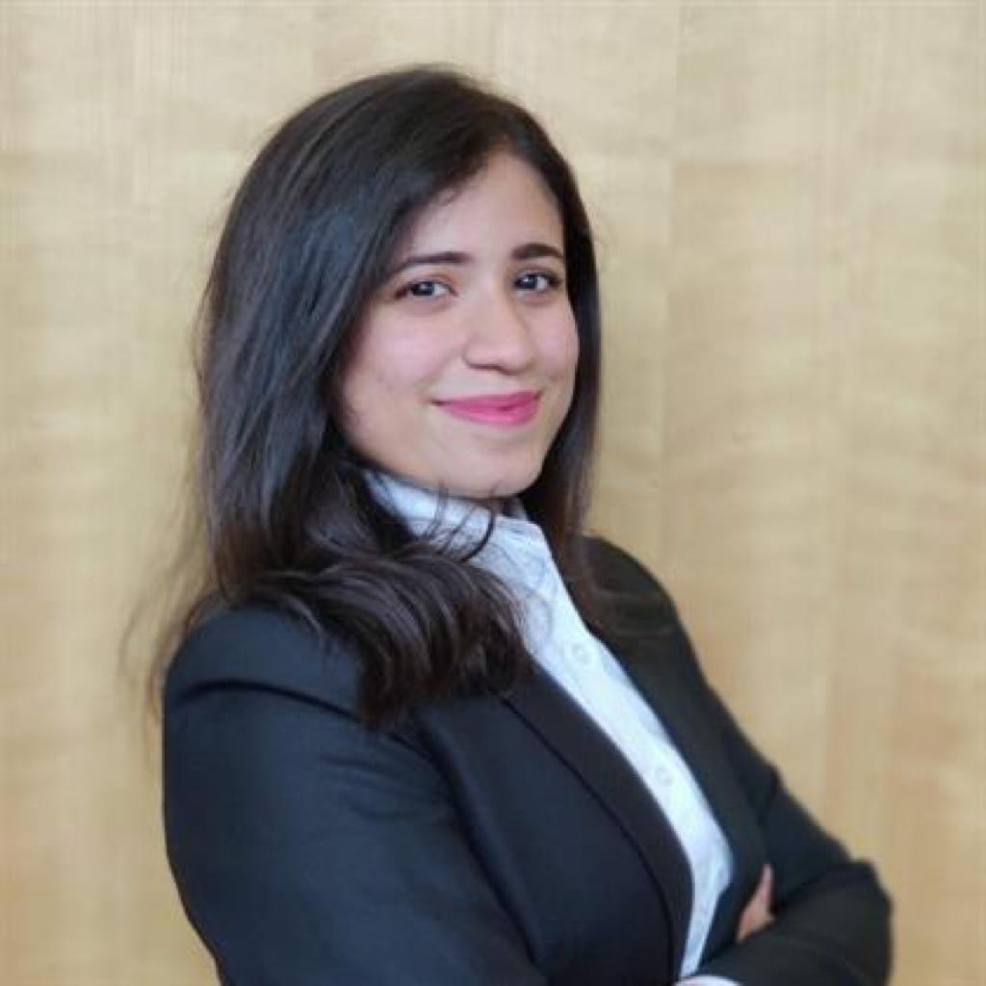

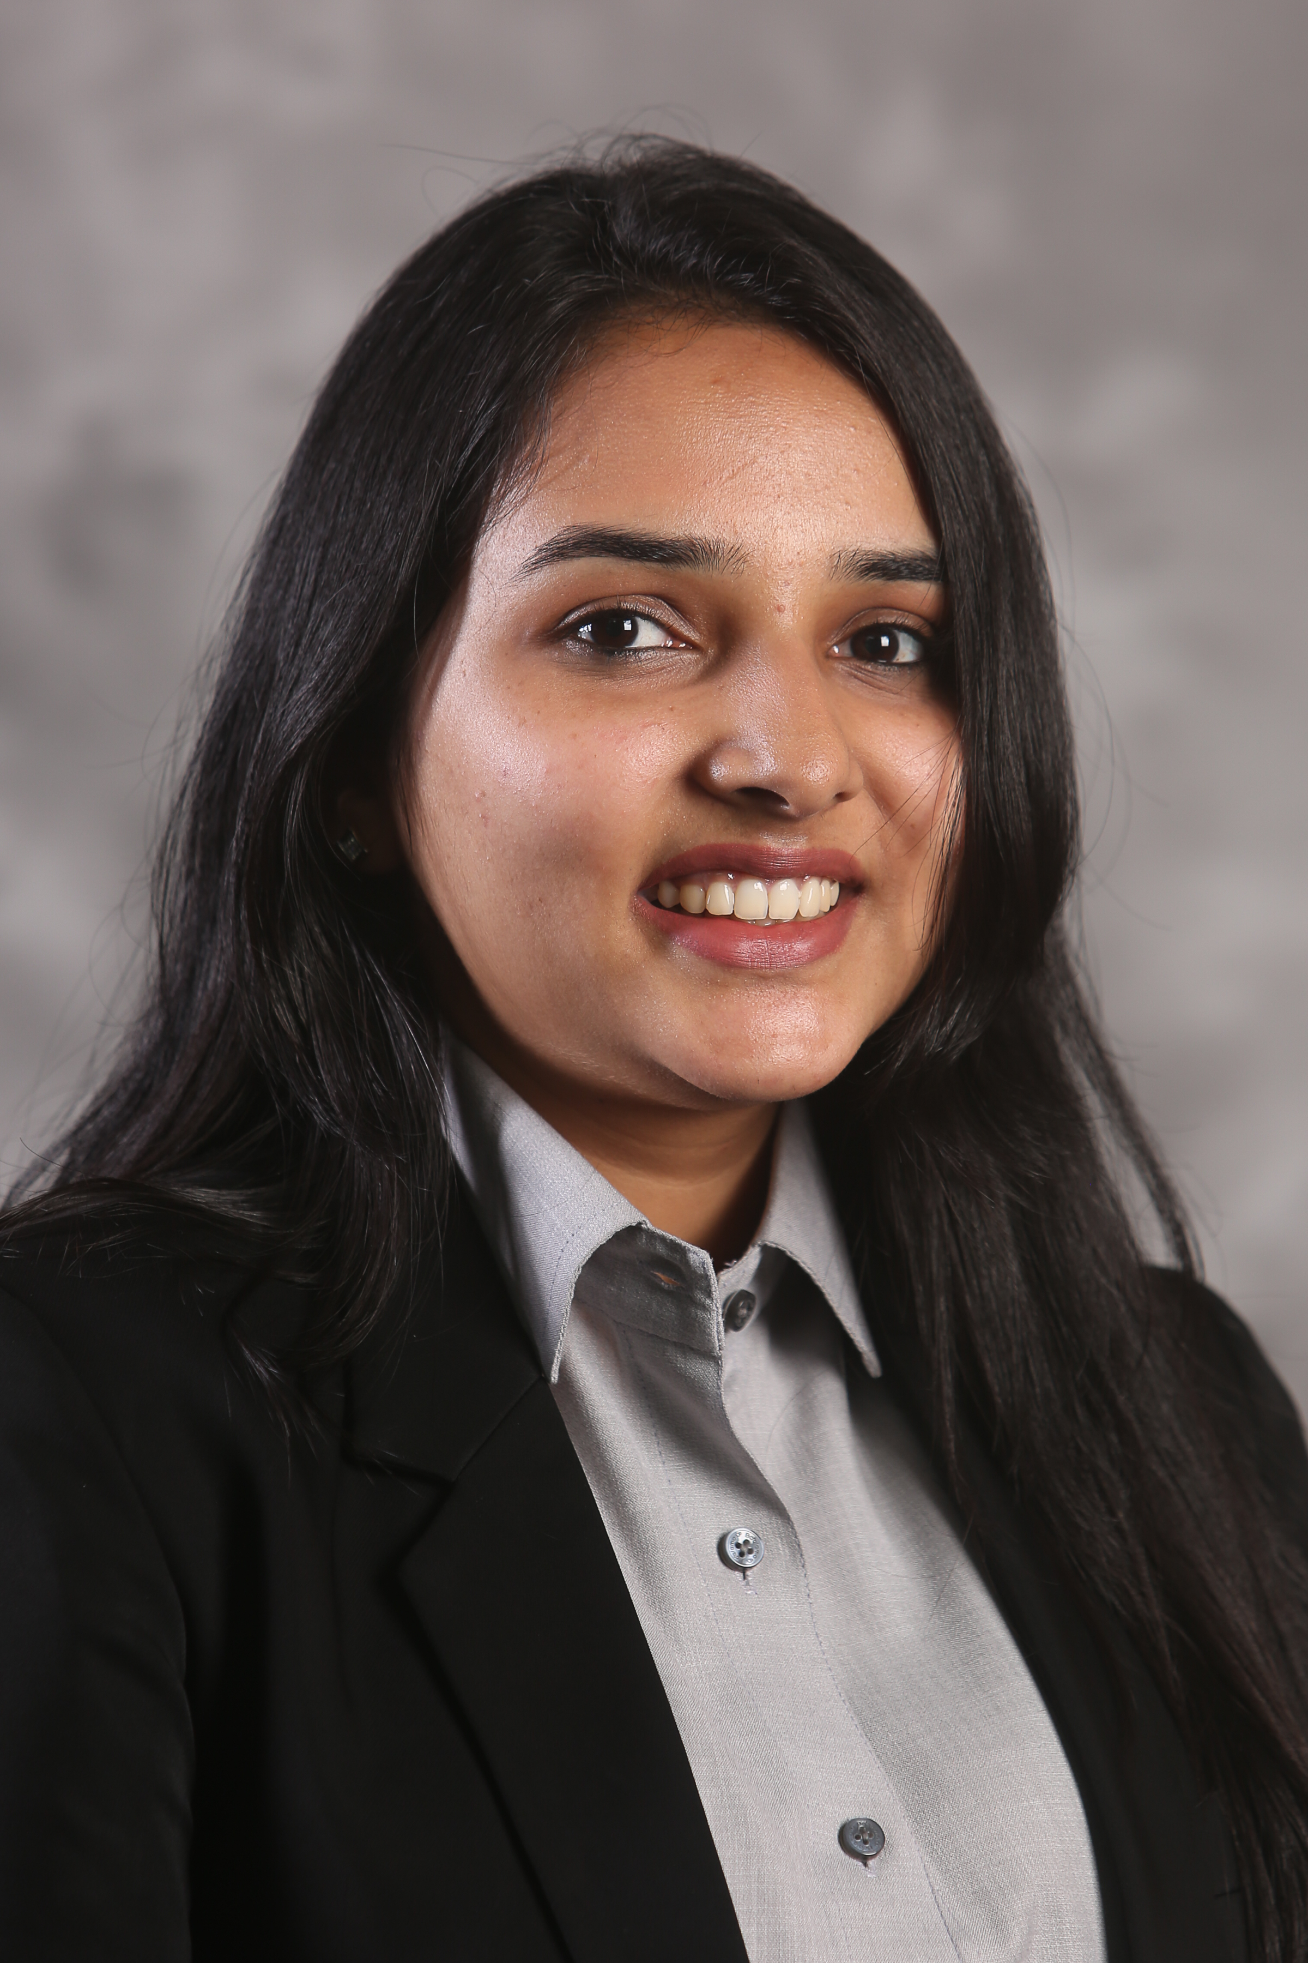
Meet the Team
Chetan S
Durriya K
Karandeep M
Nityanand K
Paridhi J
Notes:
OC TITLE SLIDE - MD
That’s awesome – and so great to see your faces traveling the world, experiencing the wonder of travel!
Next I’d like to turn it over to our President of Panorama, Olivier Chavy

Slide 3
Agenda
Business Problem
Business Benefit
Analytics Problem
Process Flow
Data
Exploratory Data Analysis
Key Questions
Business Objective
Our Approach
Data Preparation
Predictive Modeling
Clustering
Business Application
Business Impact
Precision Marketing
Conclusion and Future Recommendations
Analysis
Recommendations
Notes:
\

Slide 4
Business Objective

Slide 5


Business Problem
The problem aims at better understanding of its members how to target them based on their profile and past purchase behavior.
“What group of customers is most likely to respond to a certain promotion?”
Notes:
You have to be aware of one of the latest trending memes to get this one, but as you can see It’s Going Better Than it Started!

Slide 6

Business Benefit
Better targeting of customer leading to
Greater conversions
Cost Reduction
Notes:
You have to be aware of one of the latest trending memes to get this one, but as you can see It’s Going Better Than it Started!

Slide 7
Business to Analytics Problem Framing
To build a customer segmentation model which is scalable and feasible, a predictive model estimating likelihood of booking an exchange vacation and suggest strategies to generate greater revenues.
What
Customer Segmentation
Predictive Modeling
Why
Cost Reduction
Greater Conversions
Make it Scalable and Feasible
How
Using Python Libraries and Visualization tools

Slide 8
Data and
Our Approach

Slide 9
Data Available
Using member data of 68098 unique users across 5 countries
Member Related data- Accounts, Account Activity
Events- Search, Request
Transaction- Bookings and Deposits
Inventory- Resorts
Notes:
You have to be aware of one of the latest trending memes to get this one, but as you can see It’s Going Better Than it Started!

Slide 10
Process Flow Diagram
Data cleaning
Feature Extraction
Time Series Modelling
Forecasting customers propensity to travel
Validating Time Series Model
Clustering the customers based on their search and transaction score
CLUSTERING
DATA PREP
MODELLING
Notes:
Gathering slide

Slide 11
EDA

Slide 12
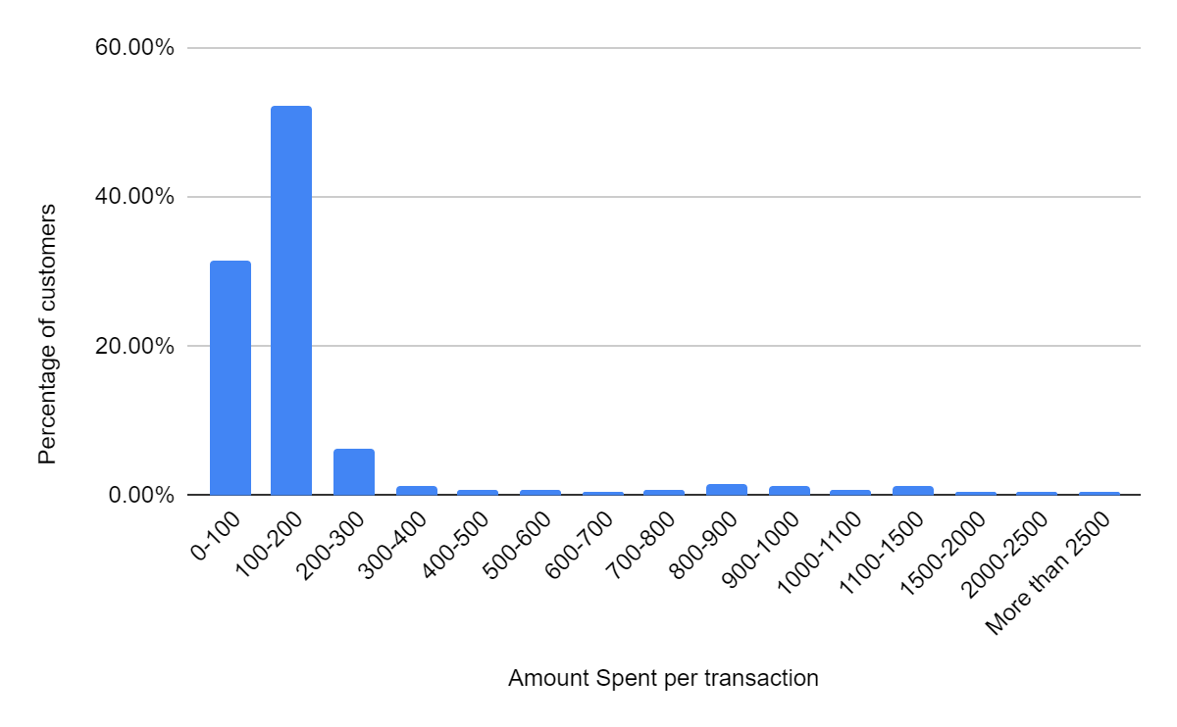
Distribution of customers based on their spending
- 90% of the customers spend on avg less than $200 per booking in the last 6 years.
- Avg Amount spent per transaction is $196
Notes:
You have to be aware of one of the latest trending memes to get this one, but as you can see It’s Going Better Than it Started!

Slide 13
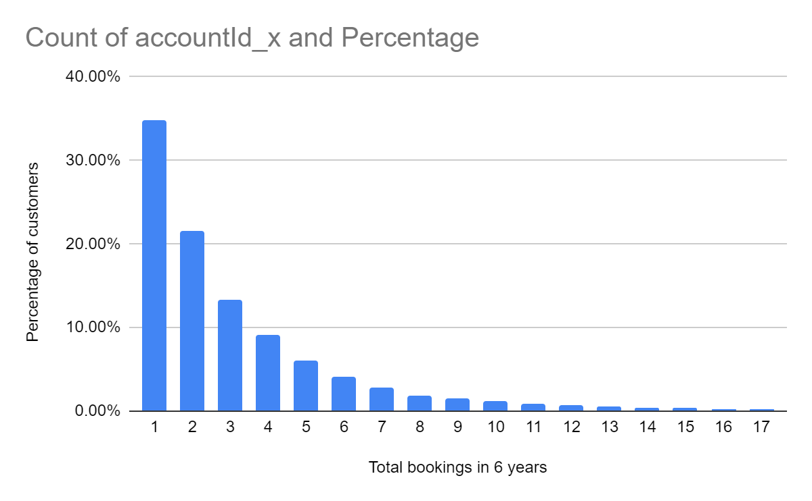
Bookings in the last 6 years
- 50% of the customers had less than 2 bookings in the last 6 years.
- Avg Amount spent per transaction is $196
Notes:
You have to be aware of one of the latest trending memes to get this one, but as you can see It’s Going Better Than it Started!

Slide 14
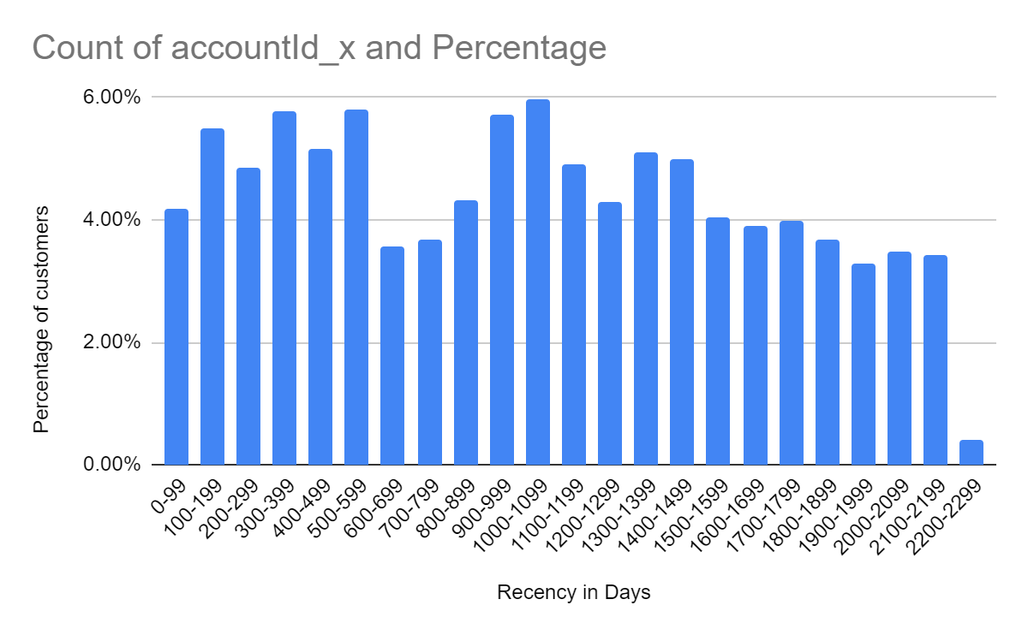
Purchase duration in the last 6 years
- Distribution of customers based on how recent is their last purchase is shown above.
- Median and Avg of the distribution is around 1000 days since the last purchase, considering last 6 years of data.
Notes:
You have to be aware of one of the latest trending memes to get this one, but as you can see It’s Going Better Than it Started!

Slide 15
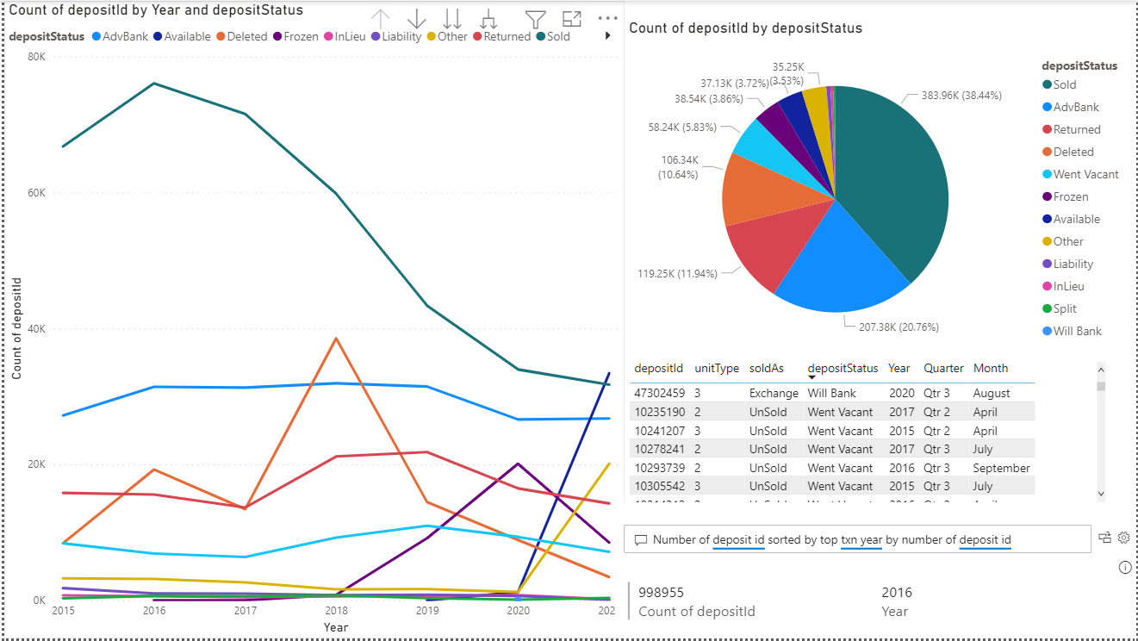
Deposit patterns
Only 40% of inventories deposited have been sold as per data, need to only look from Booking status perspective
Notes:
Amy – 5 mins

Slide 16
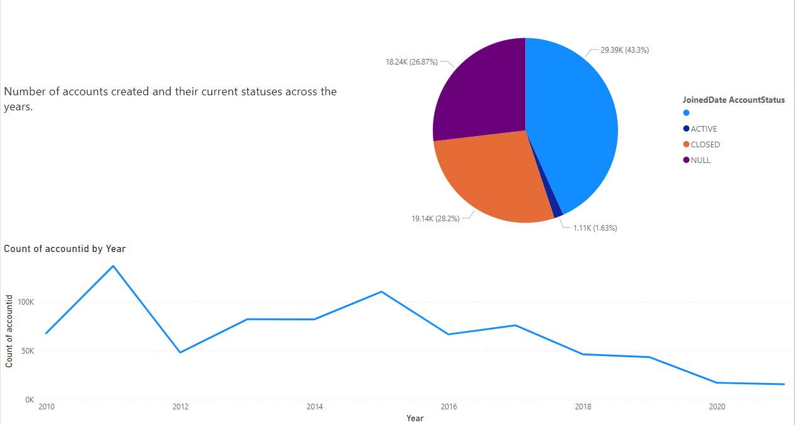
Accounts status
There is a decreasing trend in number of new accounts, a lot of Null/Missing status accounts​ now to be considered as active
Notes:
Amy – 5 mins

Slide 17
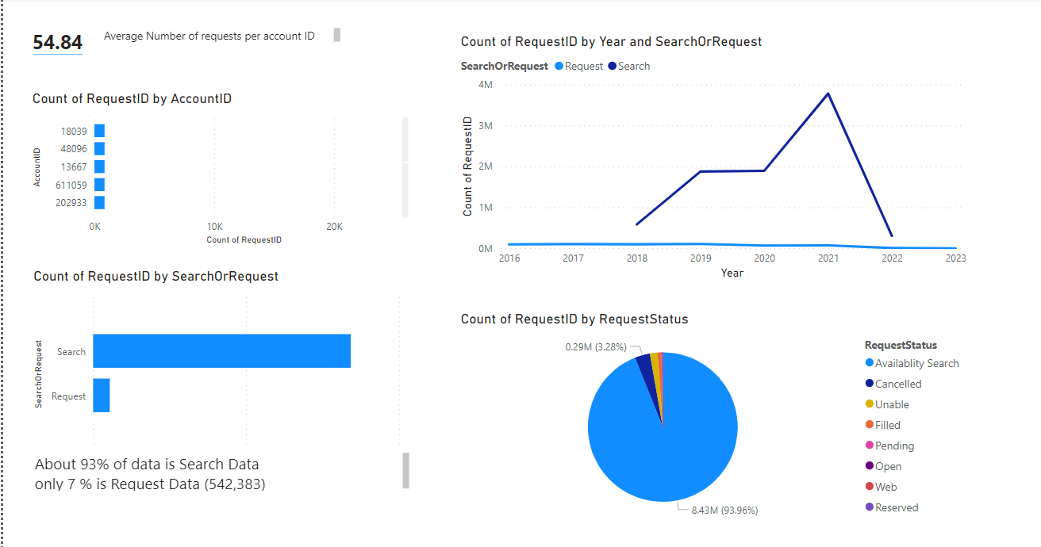
Requests Table Basic Analysis
Notes:
Amy – 5 mins

Slide 18
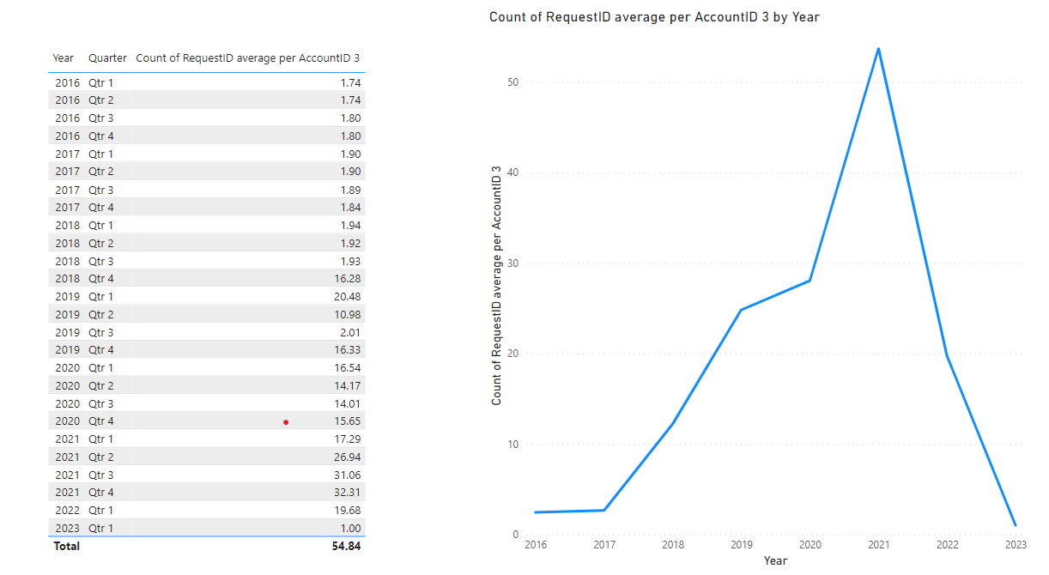
Requests Table Basic Analysis
There is an increasing trend in number of new requests
Notes:
Amy – 5 mins

Slide 19
Key Questions

Slide 20
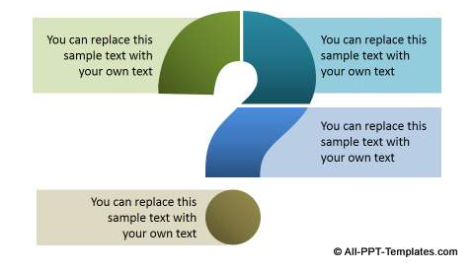
Which customers are likely to purchase?
Are old customers more likely to purchase as compared to newer customers ?
Does more number of searches means more likelihood to purchase?
How long after the deposit date are the customers purchasing ?
Do region play a role in the customer behavior/ purchase?
Notes:
You have to be aware of one of the latest trending memes to get this one, but as you can see It’s Going Better Than it Started!

Slide 21
Data Preparation

Slide 22
Timeline for Prediction Model
Response Variable : Purchased (Yes/No)
2016
2017
2018
2019 till Sept
2019 Oct – 2020 Mar
TRAINING SET
VALIDATION SET
Notes:
You have to be aware of one of the latest trending memes to get this one, but as you can see It’s Going Better Than it Started!

Slide 23

Correlation of different columns with Purchased
Response Variable : Purchased (Yes/No)
Variables
Correlation
Booking
Deposit
Search
Request
Notes:
You have to be aware of one of the latest trending memes to get this one, but as you can see It’s Going Better Than it Started!

Slide 24
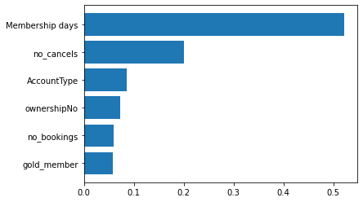
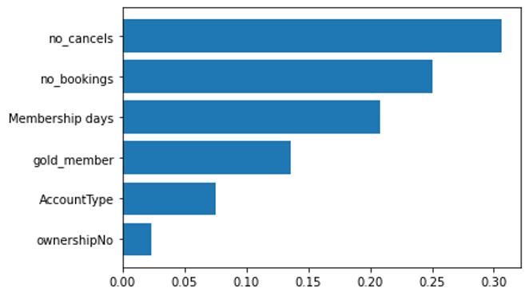
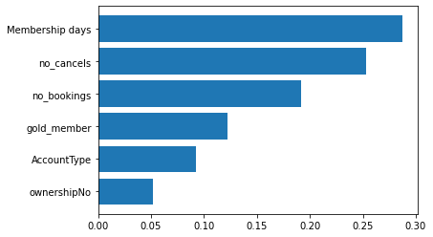
Correlation of different columns with Purchased
Decision Tree
Gradient Boost
Random Forest

Slide 25
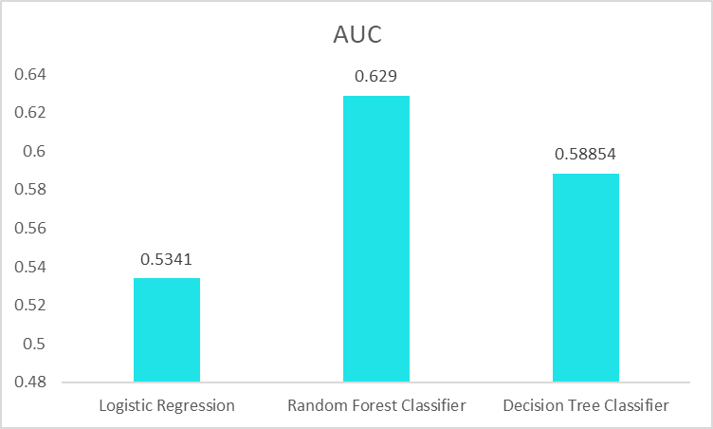
Initial Model Performance
Logistic Regression​ | Random Forest Classifier​ | Decision Tree Classifier​
0.534 | 0.629 | 0.588
Notes:
You have to be aware of one of the latest trending memes to get this one, but as you can see It’s Going Better Than it Started!

Slide 26
Clustering

Slide 27


What group of customers will purchase
Behavioral Attributes
When was the last transaction made by the customer?
What is the search behavior of customers?

Slide 28
Dormancy
Customers who have not purchased anything in the last ‘x’ months before 30th Sept 2019
2016
2017
2018
2019 till Sept
2019 Oct – 2020 Mar
PRE-PERIOD
POST PERIOD

Slide 29
Identify Dormant Customers
Dormancy
28%
Last 6 months
21%
6 to 12 months
29%
12 to 24 months
22%
More than 24 months

Slide 30
Scoring searches and transactions based on recency
Search Score = α*Search_{𝑡} + α(1- α) (Searches)_{𝑡−1} + α(1- α)^2(Searches)_{𝑡−2}
 | Jul'19 | Aug'19 | Sep'19 | Search Score
Customer1 | 1 | 12 | 2 | 2.448
Customer2 | 0 | 3 | 5 | 1.48
Considering α= 0.2
*Same scoring methodology is applied to calculate transact score.

Slide 31
Analyze Behaviour of Dormant Customers
Scoring searches and transactions based on recency
Search Score
Transact Score
28%
Last 6 months
34
24
21%
24
5
6 to 12 months
29%
8
0.8
12 to 24 months
22%
5
~0
More than 24 months
*Scores are weighted on recency and vary from 1(lowest) to 100(highest).

Slide 32
Analyze Behaviour of Dormant Customers
Scoring searches and transactions based on recency
Search Score
Transact Score
28%
Last 6 months
34
24
24
5
21%
24
5
21%
6 to 12 months
6 to 12 months
29%
8
0.8
12 to 24 months
High Searchers and low transactors are the customers of interest
22%
5
~0
More than 24 months
*Scores are weighted on recency and vary from 1(lowest) to 100(highest).

Slide 33
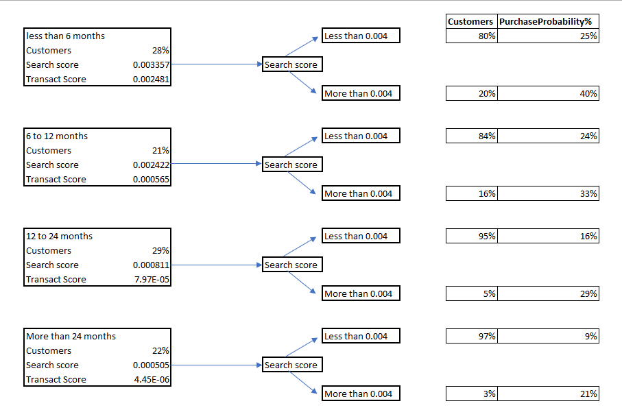
Clustering Methodology
Search Score of 0.004 taken as benchmark for a good score. 0.004 is the 90th percentile search score for all the customers under consideration.
Attractive Recommendations
Offers
Create awareness

Slide 34
Recommendations

Slide 35


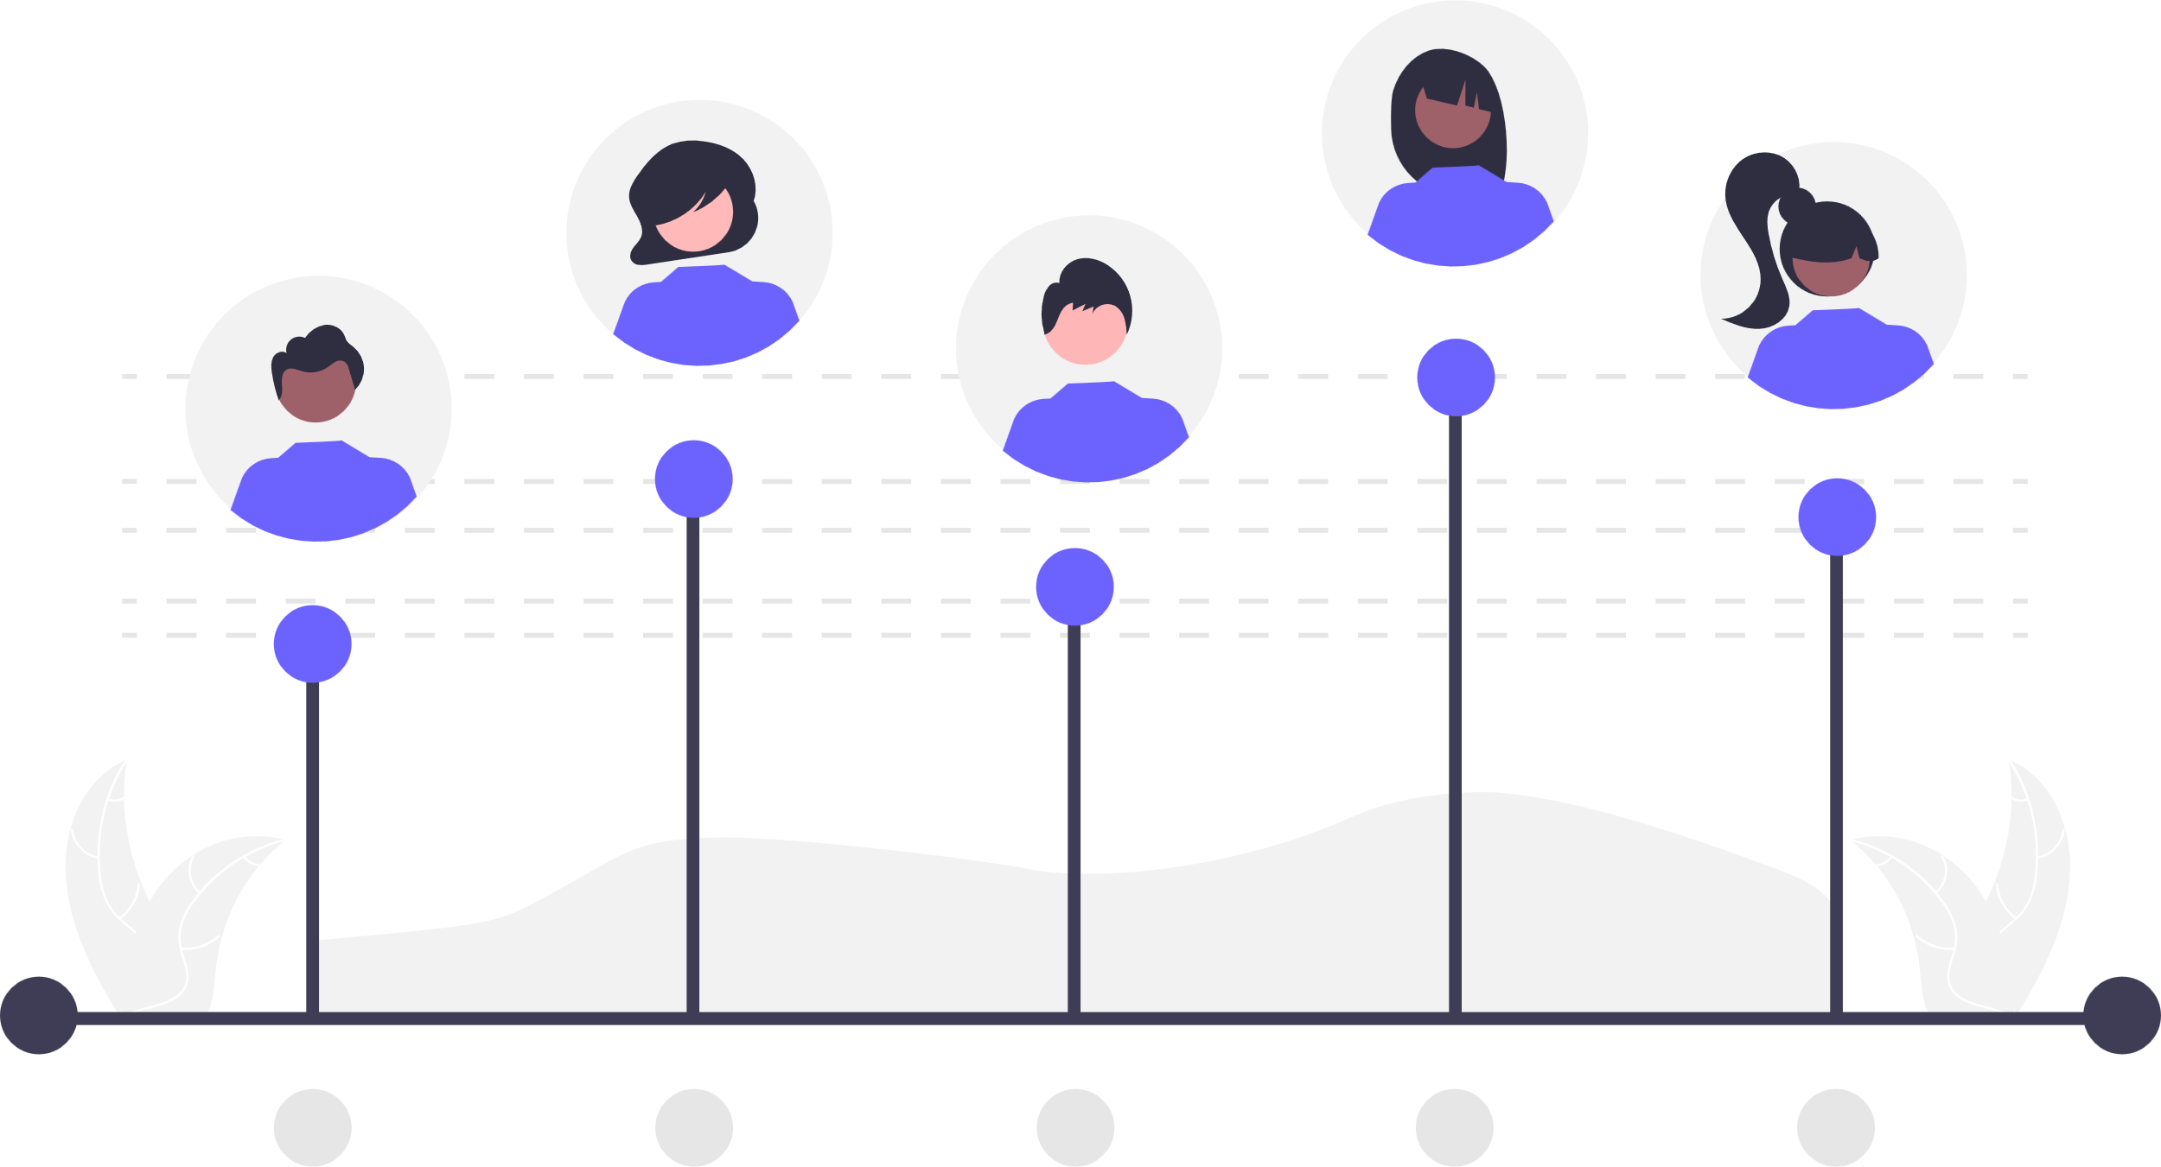
Business Application
With information of Customer’s propensity to purchase and their eagerness based on the search and transaction data, we can target them at the time when they are most likely to engage with the platform, increased the chances of their conversion and saving us the cost of advertising at low engagement times.
Understanding Member Purchase Habits
Evaluating customer’s propensity to purchase
Delivering Marketing Material to get better conversion results
Notes:
Amy – 5 mins

Slide 36
Business Impact
Cost Reduction
By calling only the target audience for each quarter who have higher propensity to purchase, we can reduce the CTA
Cost to Acquire
By sending out the marketing emails to the right target audience, we can increase the net conversion from 20% to upto 27% max
Greater Conversion
# of Bookings
Notes:
Amy – 5 mins

Slide 37

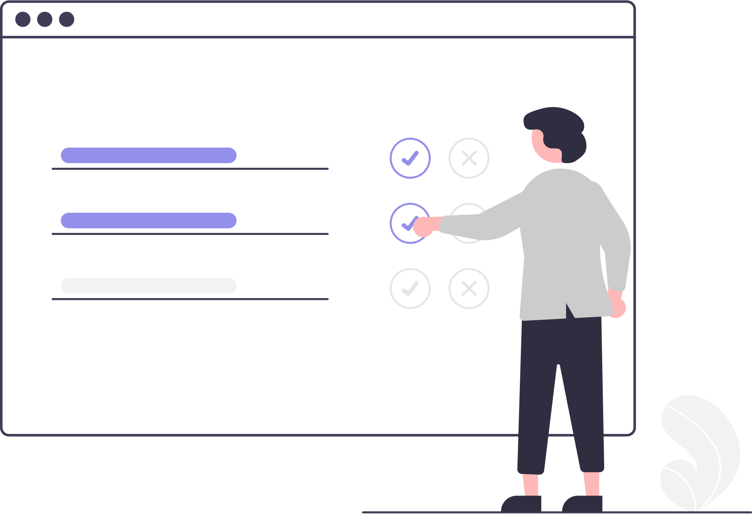


For a more refined clustering
Capturing data related to other factors that impacts a customer’s decision to travel and book an exchange vacation is equally important as their past interactions on the platform
https://forms.gle/Fn9KFnJpJQp1jZ6G7
Recency, Frequency, Monetary
Spontaneity, Experiential
Travel Logistics Preferences
Notes:
Proposed addition of log in step or sent out a survey
This will help you understand user behavior and preferences on a deeper and personal level
This data can be captured at the sign-up stage, sent out as a survey or just a section users can update before submitting the requests

Slide 38




Precision Marketing
Choose Relevant cluster based on search and transaction score
Pick a user persona based on survey results
Customize marketing communication
Deliver the message at the right time to get higher conversion
Notes:
Choose one of the clusters based on interactions
Choose a user persona from that cluster - When you create a customer as one person regardless of what device they use, you can monitor their cross-screen behavior and see which device they are most likely to use for conversions.
Fine tune your message- You can use all those insights above to personalize your marketing campaigns down to the smallest detail, targeting your customers’ specific interests and delivering your messages through the appropriate channel at just the right time when it’s time.
Message Delivery- Precision marketing is essentially about fine-tuning your message to reach the right audience. By using data and analytics, you can optimize your campaigns for increased conversions and revenue.

Slide 39


Application of Precision Marketing
A cluster with high purchase probability but low search activity
A Serial Chiller
Creating content around the theme of relaxation, beach and upcoming holidays
A marketing mail suggesting the idea of relaxing by the beach and sipping margaritas
Ready for another vacation?

Slide 40
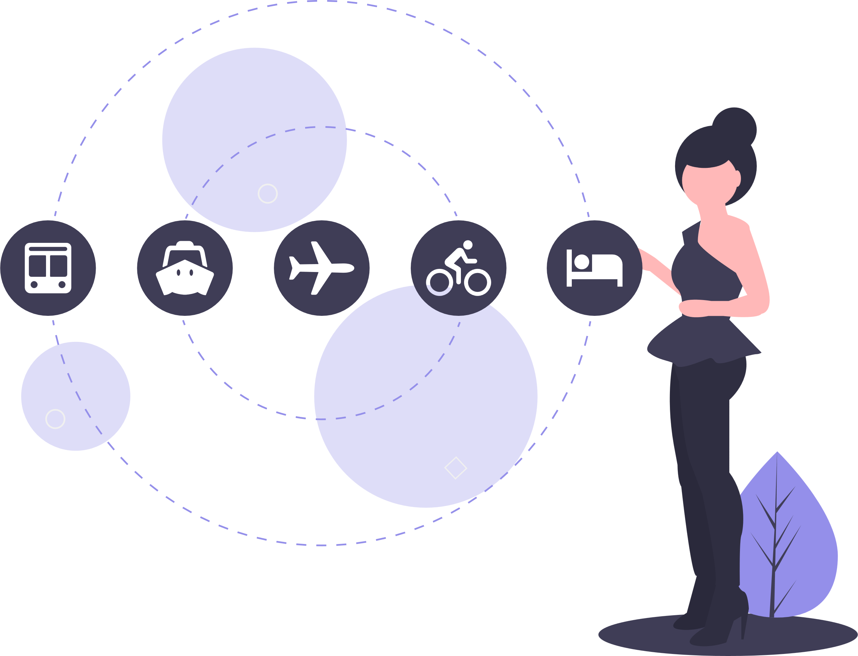

Application of Precision Marketing
A cluster with high purchase probability and high search activity
The Planner
Creating content around the theme of new experiences, itineraries, planning next vacation
A marketing mail talking about lists of things to do this fall
Top 10 places to explore this fall

Slide 41
Conclusion
Reaching out to members with high propensity to purchase
Better Conversion ratio
Cost Saving and greater revenues
Cluster Analysis
Precision Marketing
Successful Marketing Campaigns
Better Engagement
Better Business
Notes:
Reaching out to the customer when they are most likely to purchase ensures better conversion ratio and cost saving
Cluster Analysis can be combined with precision marketing to have more impactful outcomes from marketing campaigns

Slide 42


Slide 43
APPENDIX
Notes:
Gathering slide

Slide 44
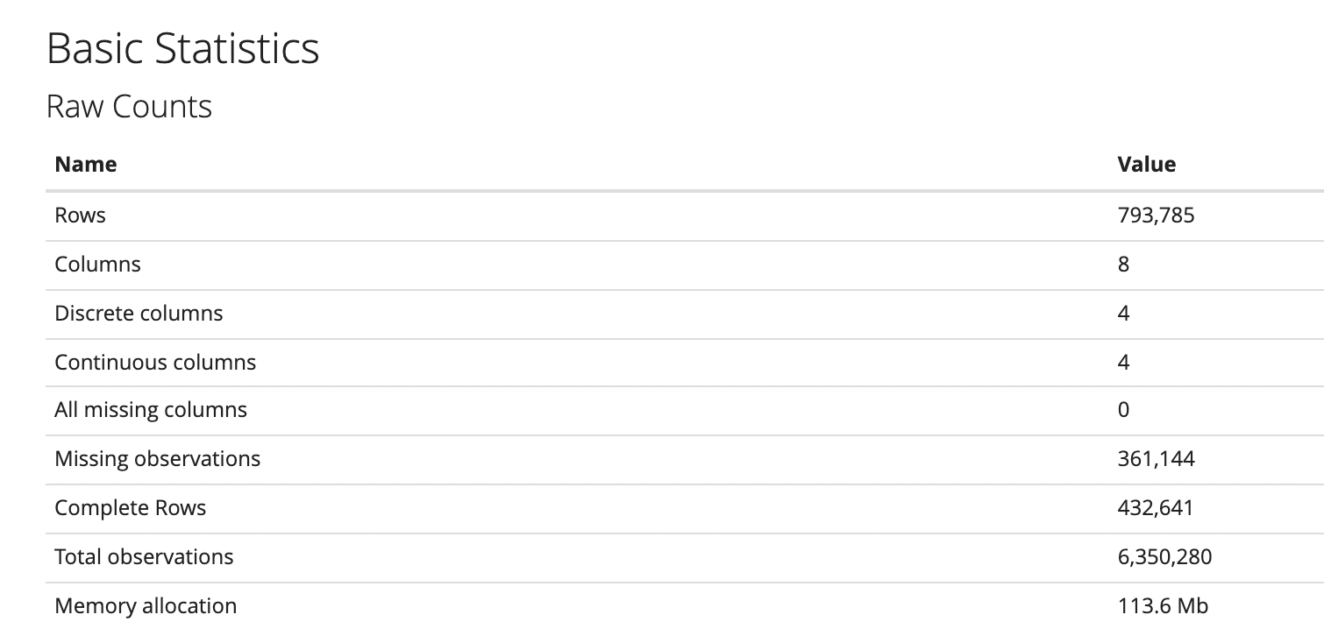
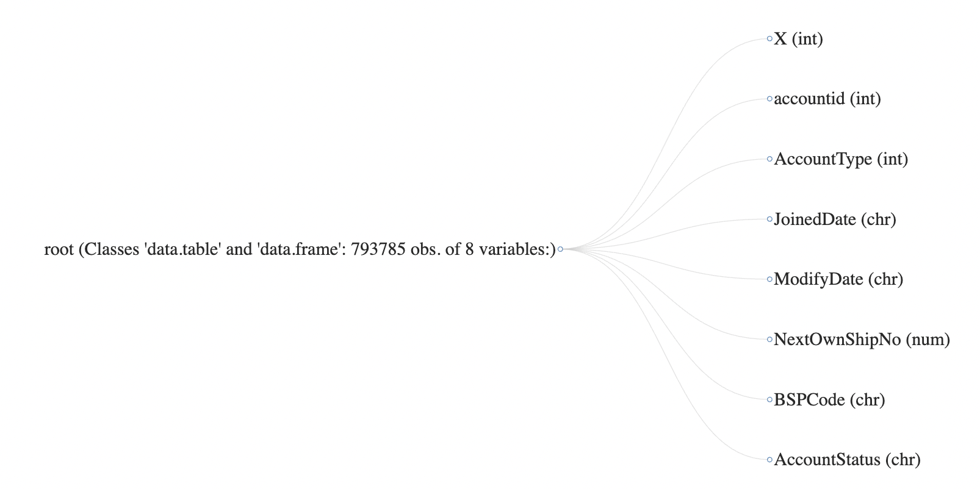
Accounts table

Slide 45
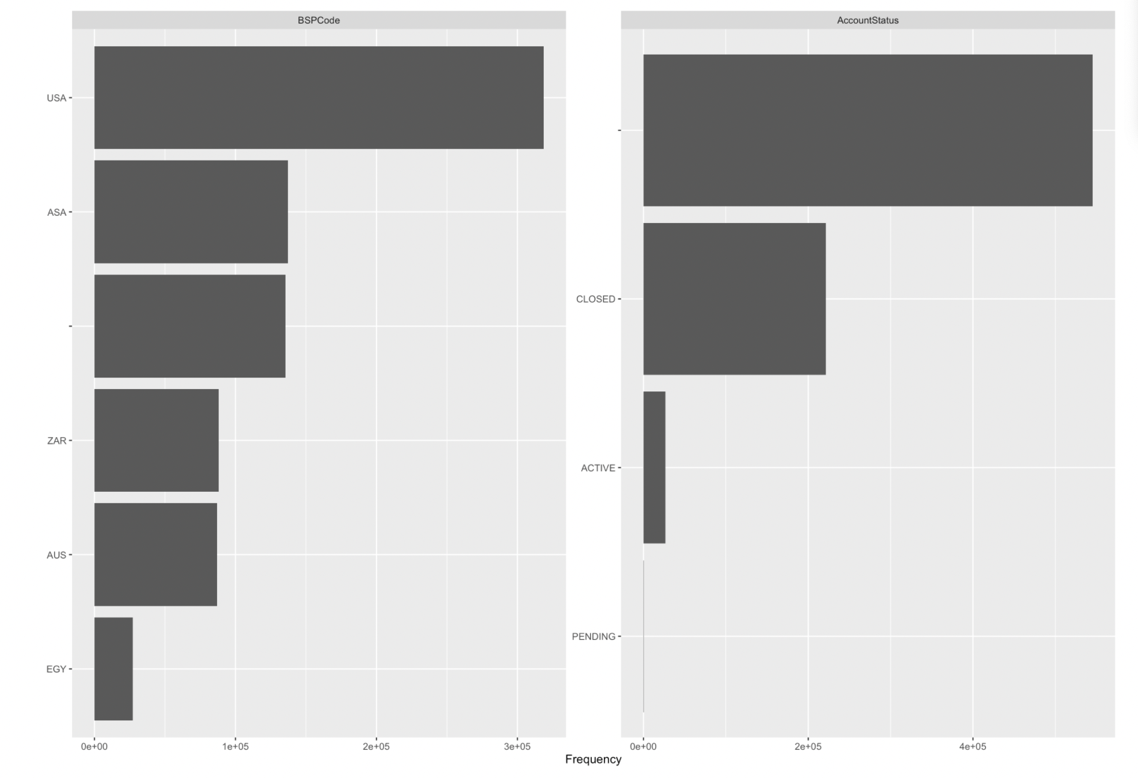
Frequency of different countries and Account Status in the table

Slide 46
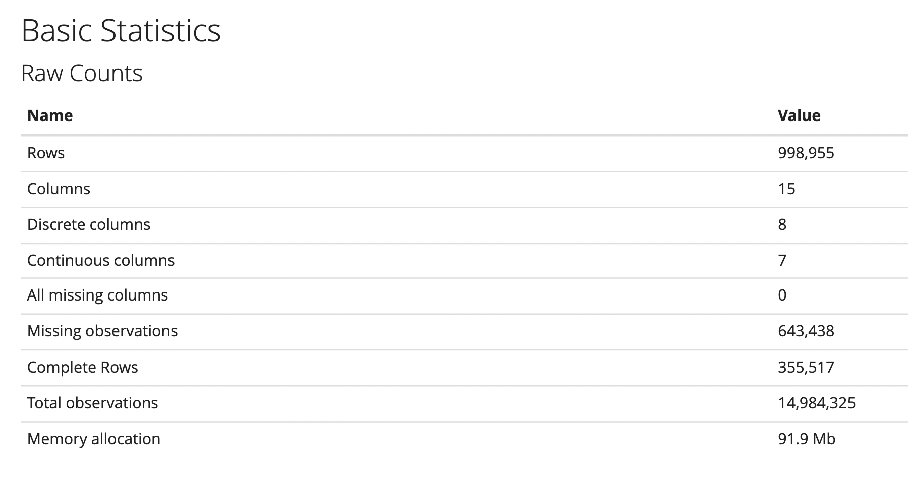
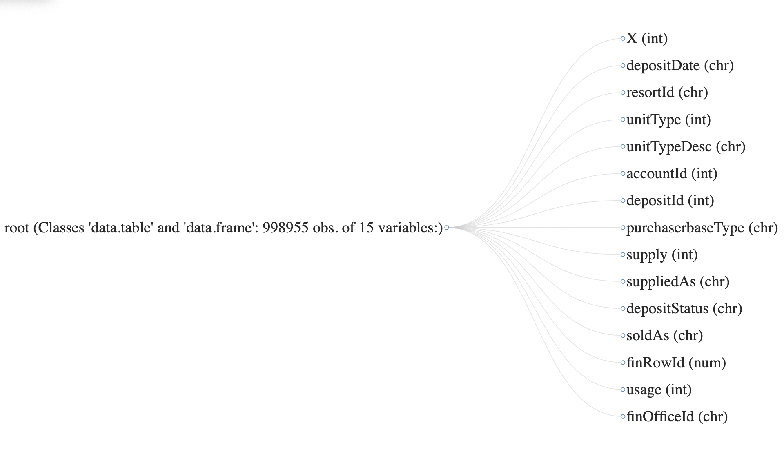
Inventory table

Slide 47
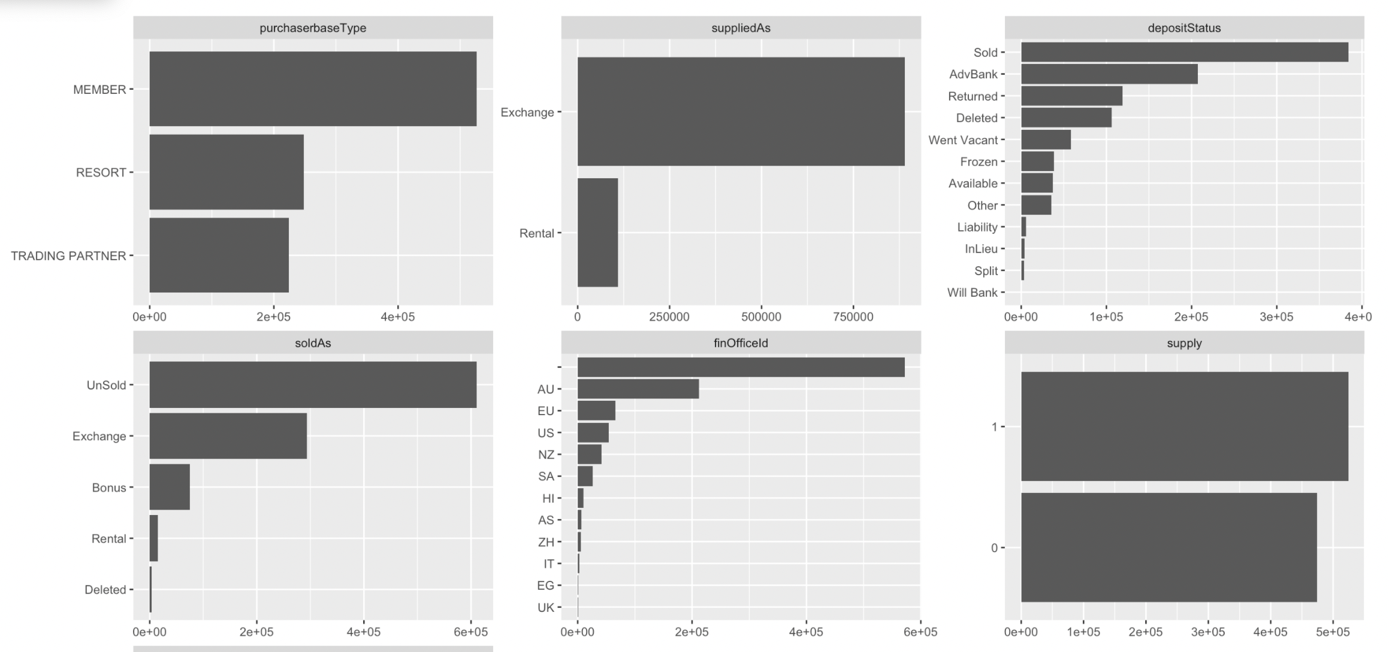

Slide 48
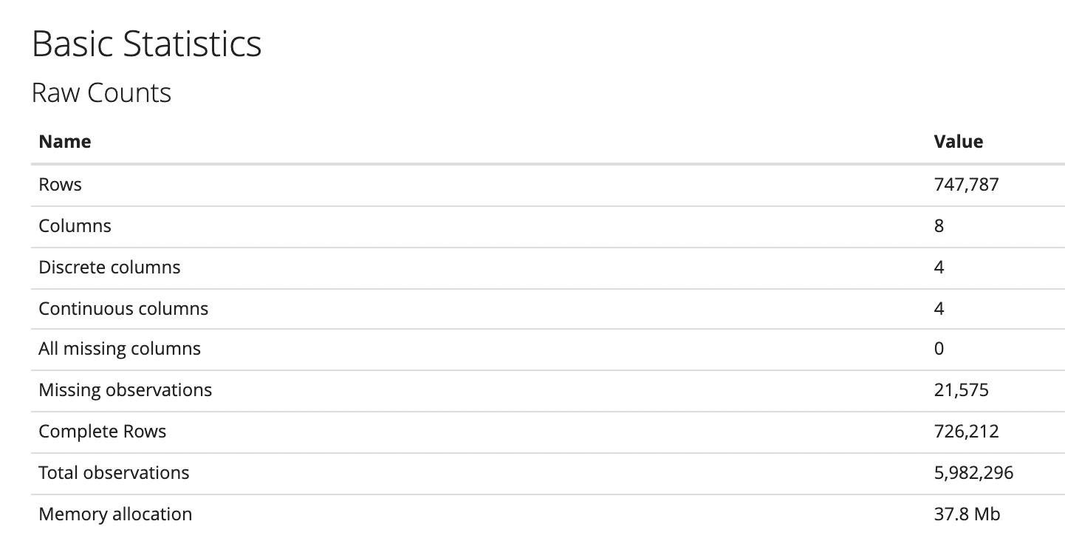
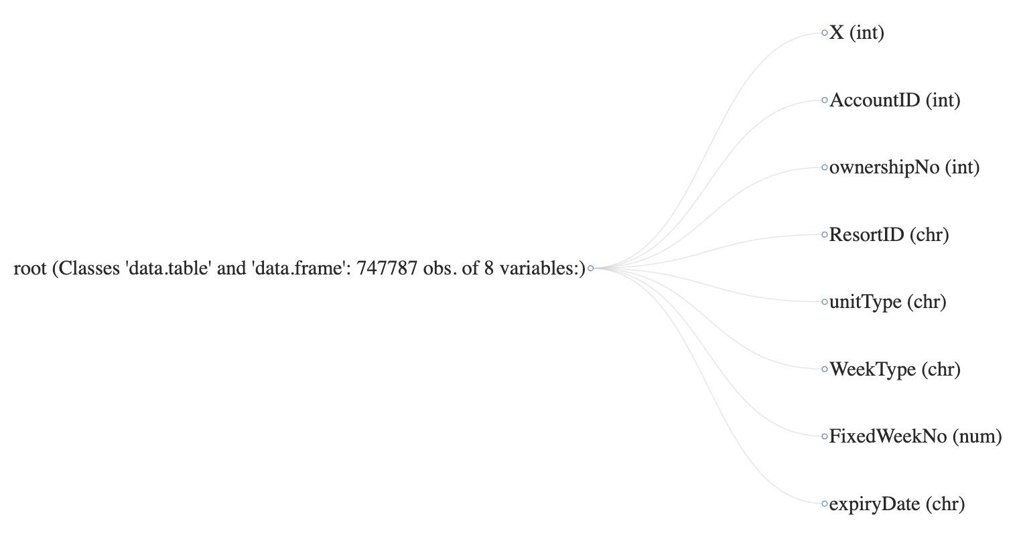
Ownership table

Slide 49
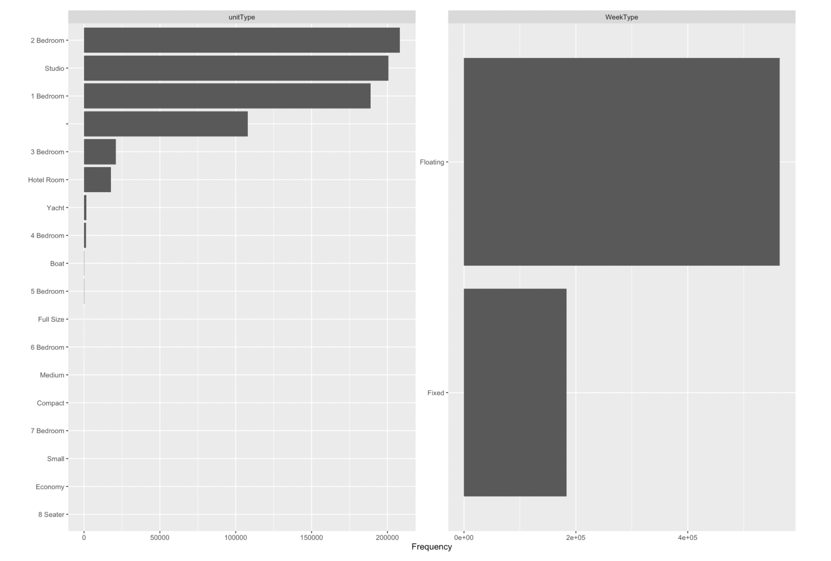
Frequency of Unit Type and Week Type in the table

Slide 50
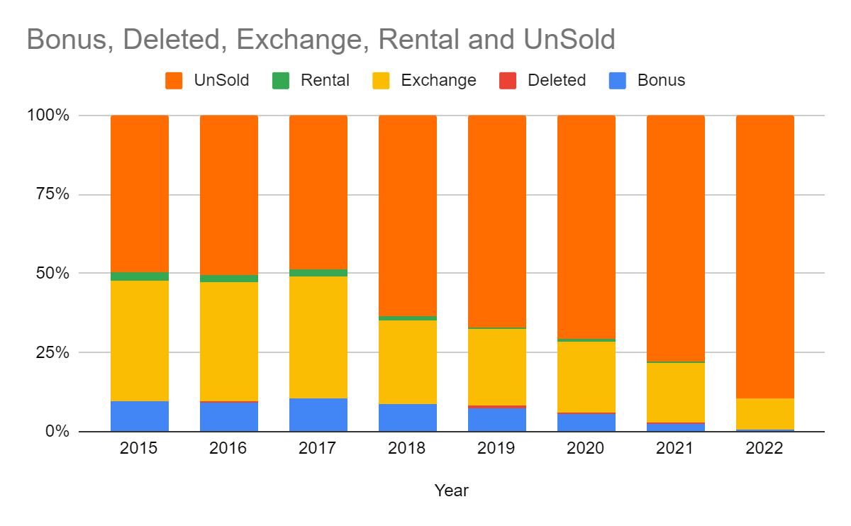
UnSold inventory has been increasing
Notes:
You have to be aware of one of the latest trending memes to get this one, but as you can see It’s Going Better Than it Started!

Slide 51
Data Discrepancy
Fixed Week Number has values more than 52.
AccountID | ownershipNo | ResortID | unitType | WeekType | FixedWeekNo
64573 | 1 | ASAPBR | 1 Bedroom | Fixed | 55
75739 | 2 | AUSBOAB | 2 Bedroom | Floating | 1425
Notes:
You have to be aware of one of the latest trending memes to get this one, but as you can see It’s Going Better Than it Started!

Slide 52
Deposits across months and years
Month/Year | 2015 | 2016 | 2017 | 2018 | 2019 | 2020 | 2021
1 | 8.36% | 6.74% | 7.02% | 7.06% | 6.53% | 9.15% | 8.15%
2 | 8.01% | 6.87% | 8.31% | 6.63% | 8.71% | 11.87% | 5.94%
3 | 10.03% | 9.72% | 7.99% | 8.74% | 6.95% | 10.97% | 6.29%
4 | 6.92% | 10.40% | 10.32% | 5.18% | 7.17% | 8.55% | 5.74%
5 | 6.48% | 7.71% | 8.77% | 10.73% | 6.21% | 7.49% | 18.91%
6 | 8.02% | 7.51% | 6.53% | 14.83% | 7.07% | 6.84% | 5.91%
7 | 6.96% | 7.05% | 6.72% | 5.98% | 13.82% | 9.53% | 4.24%
8 | 6.76% | 7.78% | 7.41% | 4.24% | 9.10% | 8.94% | 5.23%
9 | 6.84% | 7.22% | 8.05% | 9.42% | 5.86% | 7.77% | 4.45%
10 | 11.15% | 9.24% | 15.03% | 10.56% | 13.80% | 9.57% | 12.03%
11 | 10.85% | 10.28% | 8.50% | 9.33% | 9.18% | 4.35% | 13.91%
12 | 9.63% | 9.49% | 5.34% | 7.29% | 5.60% | 4.97% | 9.20%
Notes:
Amy – 5 mins

Slide 53
Transactions done by members across years/months
Year | 2016 | 2017 | 2018 | 2019 | 2020 | 2021
Month | 100.00% | 100.00% | 100.00% | 100.00% | 100.00% | 100.00%
1 | 9.02% | 10.19% | 10.15% | 9.83% | 9.45% | 8.81%
2 | 8.20% | 8.01% | 8.69% | 8.44% | 8.34% | 9.06%
3 | 8.86% | 9.72% | 9.06% | 9.08% | 7.01% | 10.53%
4 | 8.71% | 7.73% | 9.59% | 8.25% | 6.97% | 7.58%
5 | 10.22% | 11.21% | 11.71% | 11.75% | 9.71% | 9.69%
6 | 8.67% | 8.87% | 9.01% | 8.87% | 11.27% | 9.42%
7 | 7.58% | 8.06% | 7.24% | 8.28% | 9.04% | 7.98%
8 | 8.13% | 7.50% | 7.44% | 7.19% | 8.61% | 8.63%
9 | 7.19% | 6.74% | 6.71% | 7.30% | 8.62% | 8.86%
10 | 8.29% | 7.76% | 7.64% | 7.89% | 8.32% | 8.03%
11 | 7.61% | 7.45% | 6.78% | 6.36% | 6.48% | 6.16%
12 | 7.51% | 6.76% | 5.99% | 6.76% | 6.19% | 5.23%
Notes:
Amy – 5 mins

Slide 54
Model Methodology
Response Variable Distribution
Notes:
You have to be aware of one of the latest trending memes to get this one, but as you can see It’s Going Better Than it Started!

Slide 55
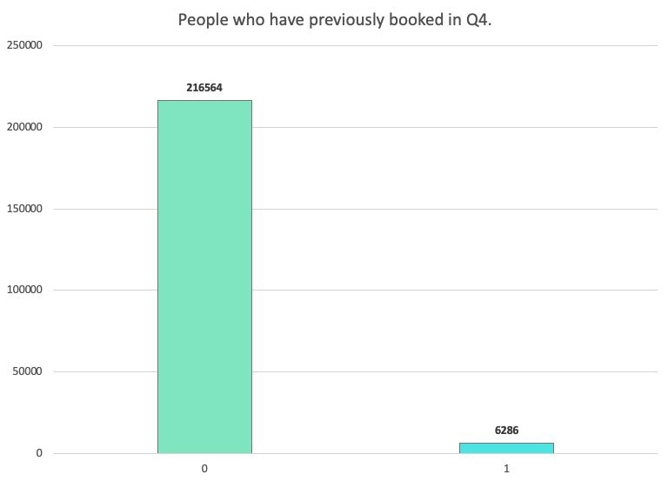
Distribution of customers who have previously booked in Q4.
6,286 people have previously booked in Q4 in the past year.
If customer did not book in Q4,
response = 0
If customer made a booking in Q4,
response = 1
Notes:
Gathering slide

Slide 56
This is important because it shows how many customers have previously booked based on past booking activity.
It’s important to note that, at least in Q4, there is skewed distribution (more 0s than 1s). We need to accommodate this in our model as skewed distributions can lead to poor model performance.
Notes:
Gathering slide

Slide 57
Model Methodology
Initial Model Performances
Notes:
You have to be aware of one of the latest trending memes to get this one, but as you can see It’s Going Better Than it Started!

Slide 58
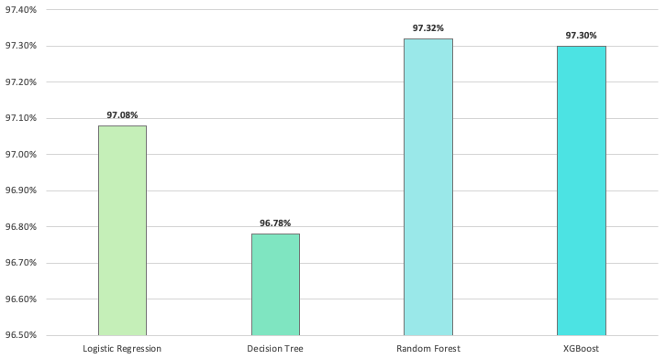
Random Forest model has the highest accuracy percentage.
Accuracy is not the best metric to measure against as current data is highly skewed.
Notes:
Gathering slide

Slide 59
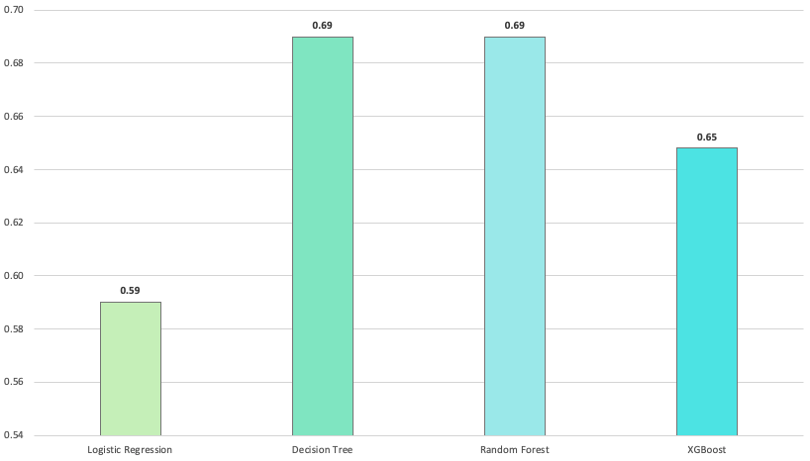
Both the Decision Tree and Random Forest models have the highest ROC.
Looking at ROC is a better metric to use as it’s a more accurate assessment of performance.
Notes:
Gathering slide

Slide 60
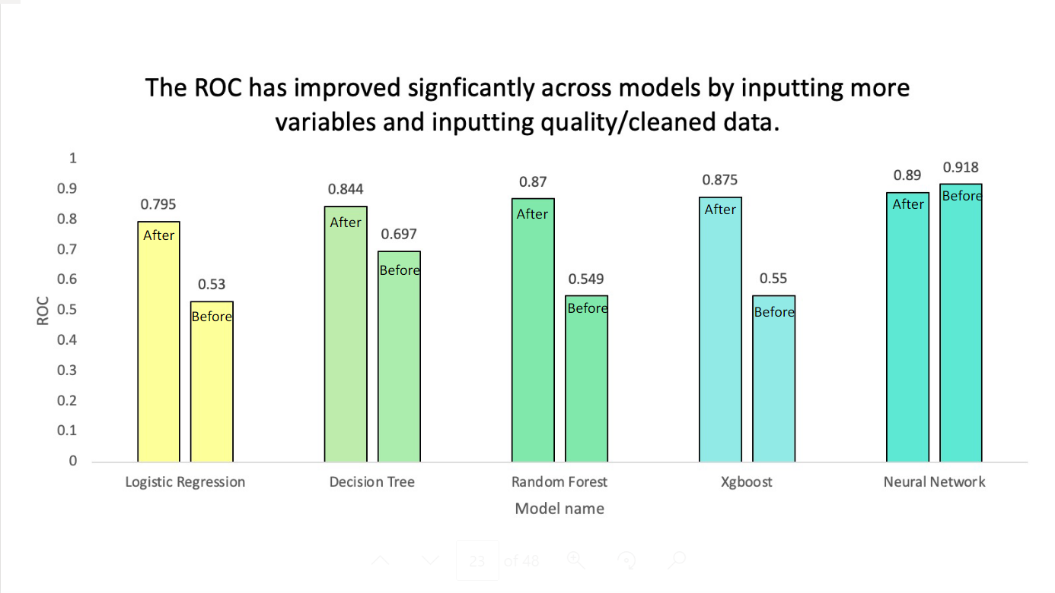
Random Forest model has a good accuracy and interpretability as compared to other models
Looking at ROC is a better metric to use as it’s a more accurate assessment of performance.
Notes:
Gathering slide

Slide 61
Data Dictionary
https://drive.google.com/file/d/1tZXmHi2BO6ZrCVCrsPeGMjAHZu0p3dIi/view?usp=sharing
Notes:
Amy – 5 mins

Slide 62
Sunset header
Xyz..
7Across members can enjoy travel with:
Simplicity –
Notes:
BACKRUB // GOOGLE
BRAD’S DRINK // PEPSI
BLUE RIBBON SPORTS // NIKE
SOUND OF MUSIC // BEST BUY
GOODFELLOW’S DRY GOODS COMPANY // TARGET
RELENTLESS // AMAZON

Slide 63
Spark features
Simplicity
Value
Transparency

Slide 64
Bullet points
It’s so fresh
Spark!
Forward to the Future
Fun, for real
Motion across the Ocean
Diverse
Makes me proud to be a part of

Slide 65

Full page image
Exchange
Simple 1:1 Exchange
The freedom to choose
With 7Across, you can travel your way with simple Flexible & Non-flexible booking options on Exchange & Bonus weeks.
Bonus
Last minute weeks, for cash
Rental
Rent weeks in dream locations
Notes:
Simplicity

Slide 66

More feature box options
Bold
On the
move
Straight
shooting

Slide 67
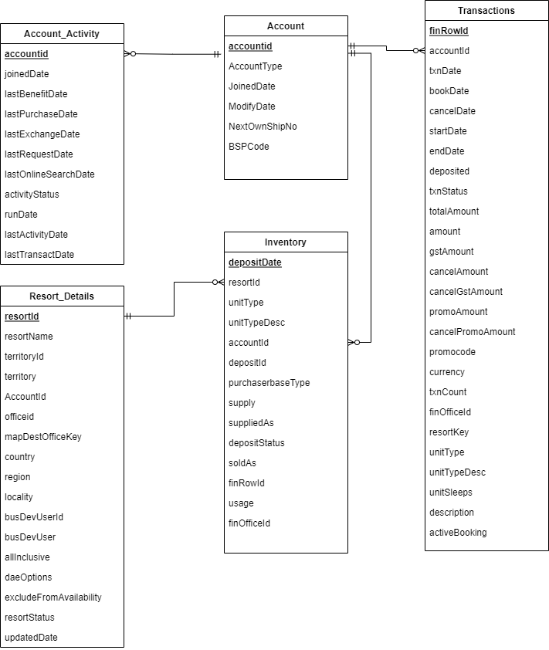
ER Diagram
https://drive.google.com/file/d/1tZXmHi2BO6ZrCVCrsPeGMjAHZu0p3dIi/view?usp=sharing
Notes:
Amy – 5 mins

Slide 68
Sunrise header – use this one mostly

Slide 69
Conclusion
Xyz..
7Across members can enjoy travel with:
Simplicity –

Slide 70
Cost Reduction
Greater Revenues
Greater Conversion

